Slide 1
Lecture 3

Slide 2
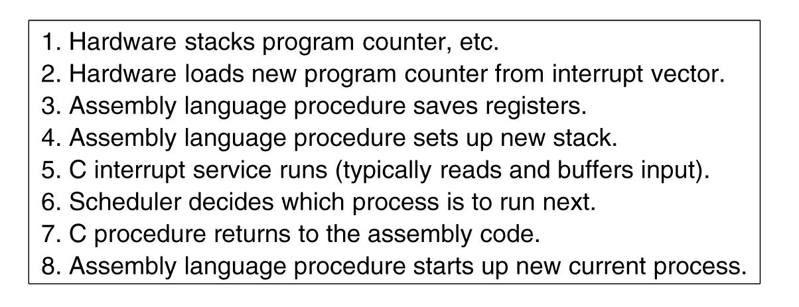
OS processes an interrupt (read only)
Associated with each I/O class is a location called the interrupt vector. It contains the address of the interrupt service procedure. Suppose that user process 3 is running when a disk interrupt happens. What happens?
Skeleton of what the lowest level of the operating system does when an interrupt occurs.
Tanenbaum, Modern Operating Systems 3 e, (c) 2008 Prentice-Hall, Inc. All rights reserved. 0-13-6006639

Slide 3
Threads
Each process has an address space and a single thread of control. In fact, that is almost the definition of a process. Nevertheless, in many situations, it is desirable to have multiple threads (miniprocesses) of control in the same address space as though they were separate processes (except for the shared address space).
The main reason for having threads is that in many applications, multiple activities are going on at once. Some of these may block from time to time. By decomposing such an application into multiple sequential threads that run in quasi-parallel, the programming model becomes simpler.
A process is a program under execution i.e an active program. A thread is a lightweight process that can be managed independently by a scheduler. Processes require more time for context switching as they are more heavy. Threads require less time for context switching as they are lighter than processes.

Slide 4
Example
Suppose that the word processor is written as a two threaded program. One thread interacts with the user and the other handles reformatting in the background.
As soon as a sentence is deleted from page 1, the interactive thread tells the reformatting thread to reformat the whole document. Meanwhile, the interactive thread continues to listen to the keyboard and mouse and responds to simple commands like scrolling page 1.
Many word processors have a feature of automatically saving the entire file to disk every few minutes to protect the user against a program crash, system crash, or power failure. A third thread can handle the disk backups without interfering with the other two.

Slide 5
A Multithreaded Web Server
A server for a Website. Requests for pages come in and the requested page is sent back to the client.
At most Websites, some pages are more commonly accessed than other pages. Web servers use this to improve performance by maintaining a collection of heavily used pages in the cache.
One way to organize the Web server is shown in the next figure one thread, the dispatcher, reads incoming requests for work from the network. It chooses an idle (i.e., blocked) worker thread and hands it the request.
The dispatcher then wakes up the sleeping worker, moving it from blocked state to ready state.
Tanenbaum, Modern Operating Systems 3 e, (c) 2008 Prentice-Hall, Inc. All rights reserved. 0-13-6006639

Slide 6
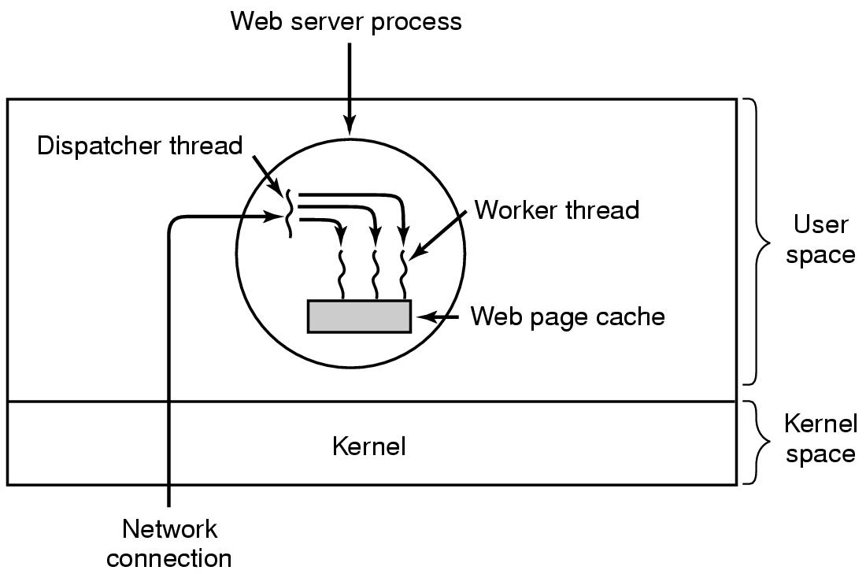
A Multithreaded Web Server
Tanenbaum, Modern Operating Systems 3 e, (c) 2008 Prentice-Hall, Inc. All rights reserved. 0-13-6006639

Slide 7
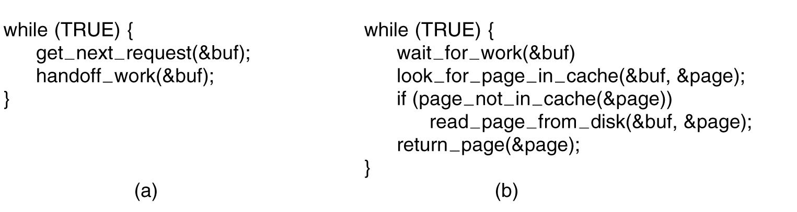
A Multithreaded Web Server
If page is not in the cache, it starts a read operation to get the page from the disk and blocks until the disk operation completes.
CPU does nothing while it waits for the page
Thread structure enables the server to look up another page and get something done
(a) Dispatcher thread. (b) Worker thread.
Tanenbaum, Modern Operating Systems 3 e, (c) 2008 Prentice-Hall, Inc. All rights reserved. 0-13-6006639

Slide 8
A Single-threaded Web Server
Consider how the Web server could be written in the absence of threads.
One possibility is to have it operate as a single thread.
The main loop of the Web server gets a request, examines it, and carries it out to completion before getting the next one.
While waiting for the disk, the server is idle and does not process any other incoming requests.
The CPU is simply idle while the Web server is waiting for the disk.
The net result is that many fewer requests/sec can be processed.
The single-threaded server retains the simplicity of blocking system calls but gives up performance.
Tanenbaum, Modern Operating Systems 3 e, (c) 2008 Prentice-Hall, Inc. All rights reserved. 0-13-6006639

Slide 9
Finite state machine
When a request comes in, the one and only thread examines it. If it can be satisfied from the cache, fine, but if not, a nonblocking disk operation is started.
The server records the state of the current request in a table and then goes and gets the next event.
When the thread returns the page send an interrupt or signal to the CPU
Achieves high performance through parallelism but uses nonblocking calls and interrupts and thus is hard to program.
Tanenbaum, Modern Operating Systems 3 e, (c) 2008 Prentice-Hall, Inc. All rights reserved. 0-13-6006639

Slide 10
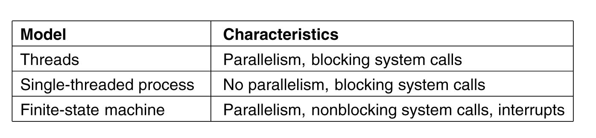
Three ways to build the server
Tanenbaum, Modern Operating Systems 3 e, (c) 2008 Prentice-Hall, Inc. All rights reserved. 0-13-6006639

Slide 11
Reasons to use multithreads
Enables parallelism (web server) with blocking system calls
Threads are faster to create and destroy than processes
Natural for multiple cores
Easy programming model
Tanenbaum, Modern Operating Systems 3 e, (c) 2008 Prentice-Hall, Inc. All rights reserved. 0-13-6006639

Slide 12
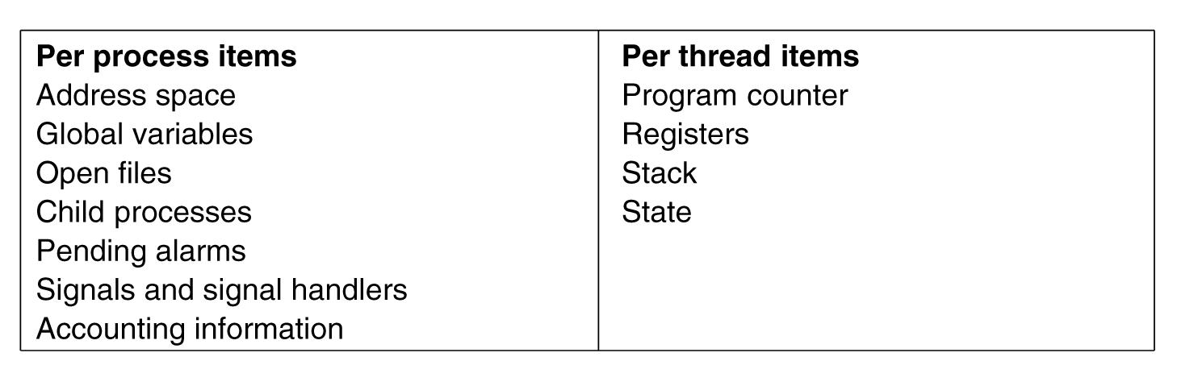
Threads are called lightweight processes
Tanenbaum, Modern Operating Systems 3 e, (c) 2008 Prentice-Hall, Inc. All rights reserved. 0-13-6006639

Slide 13
Threads are like processes
Have the same states
Running
Ready
Blocked
Have their own stacks –same as processes
Stacks contain frames for (un-returned) procedure calls
Local variables
Return address to use when the procedure comes back
Tanenbaum, Modern Operating Systems 3 e, (c) 2008 Prentice-Hall, Inc. All rights reserved. 0-13-6006639

Slide 14
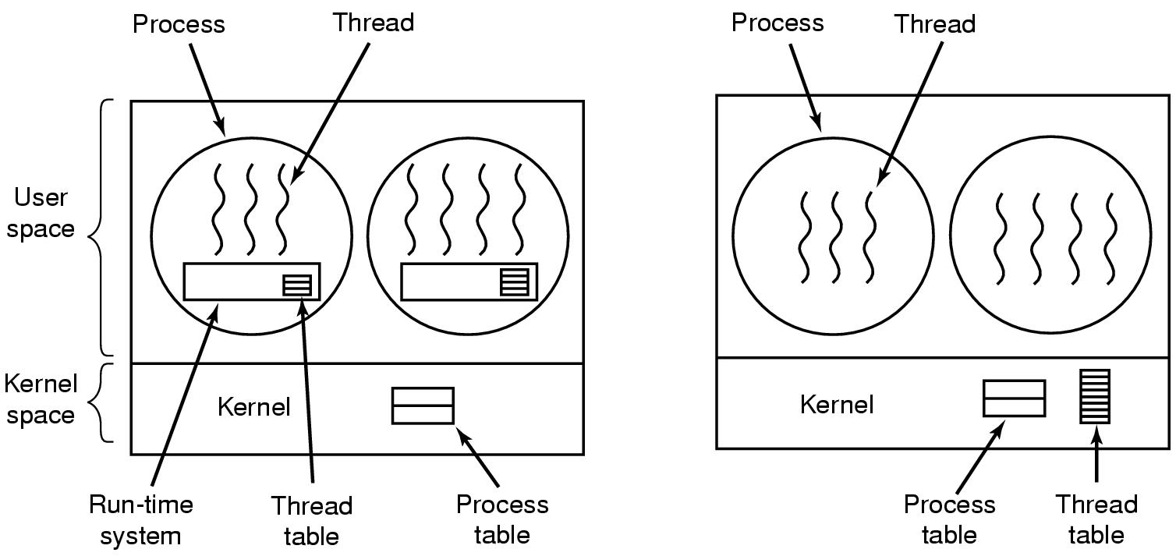
Implementing Threads
(a) A user-level threads package. (b) A threads package managed by the kernel.
Tanenbaum, Modern Operating Systems 3 e, (c) 2008 Prentice-Hall, Inc. All rights reserved. 0-13-6006639

Slide 15
Threads in user space
The first method is to put the threads package entirely in user space. The kernel knows nothing about them. As far as the kernel is concerned, it is managing ordinary, single-threaded processes.
The threads run on top of a run-time system, which is a collection of procedures that manage threads.
The Thread table contains info about threads (program counter, stack pointer...) so that run time system can manage them
If a thread blocks, run time system stores thread info in the table and finds a new thread to run.
Advantages:
1- A user-level threads package can be implemented on an operating system that does not support threads.
2- They allow each process to have its own customized scheduling algorithm.
3- They also scale better, since kernel threads invariably require some table space and stack space in the kernel, which can be a problem if there are a very large number of threads.
Tanenbaum, Modern Operating Systems 3 e, (c) 2008 Prentice-Hall, Inc. All rights reserved. 0-13-6006639

Slide 16
Threads in user space-disadvantages
Can’t let threads execute system call which blocks because it will block all of the other threads
Solution
The system calls could all be changed to be nonblocking but requiring changes to the operating system is unattractive.
To tell in advance if a call will block. Problem: This approach requires rewriting parts of the system call library, and is inefficient and inelegant, but there is little choice.
Threads do not voluntarily give up CPU.
Within a single process, there are no clock interrupts, making it impossible to schedule processes round-robin fashion (taking turns).
Solution
One possible solution to the problem of threads running forever is to have the run-time system request a clock signal (interrupt) once a second to give it control. Problem: Overhead of this solution is a problem.
Tanenbaum, Modern Operating Systems 3 e, (c) 2008 Prentice-Hall, Inc. All rights reserved. 0-13-6006639

Slide 17
Threads in kernel
Kernel knows about and manages threads.
The kernel’s thread table holds each thread’s registers, state, and other information. The information is the same as with user-level threads, but now kept in the kernel instead of in user space.
All calls that might block a thread are implemented as system calls, at considerably greater cost than a call to a run-time system procedure.
Advantages:
1- If a thread blocks, kernel just picks another one
Not necessarily from same process!
2- Kernel threads do not require any new, nonblocking system calls. If one thread in a process causes a page fault, the kernel can easily check to see if the process has any other runnable threads, and if so, run one of them while waiting for the required page to be brought in from the disk.
Tanenbaum, Modern Operating Systems 3 e, (c) 2008 Prentice-Hall, Inc. All rights reserved. 0-13-6006639

Slide 18
Threads in kernel
Disadvantages:
The cost of a system call is substantial, so ordinary thread operations (creation, termination, etc.) create much more overhead.
Tanenbaum, Modern Operating Systems 3 e, (c) 2008 Prentice-Hall, Inc. All rights reserved. 0-13-6006639

Slide 19
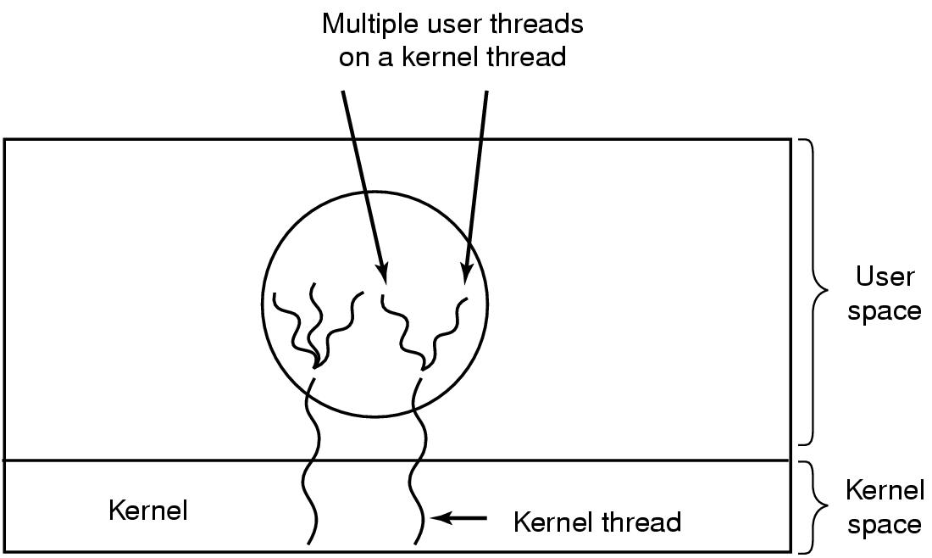
Hybrid approach
Multiplex user-level threads onto kernel level threads
Tanenbaum, Modern Operating Systems 3 e, (c) 2008 Prentice-Hall, Inc. All rights reserved. 0-13-6006639

Slide 20
Hybrid approach
Kernel is aware of kernel threads only
User level threads are created and destroyed independently of kernel thread
Programmer determines how many user level and how many kernel level threads to use
This model gives the ultimate in flexibility.
Tanenbaum, Modern Operating Systems 3 e, (c) 2008 Prentice-Hall, Inc. All rights reserved. 0-13-6006639

Slide 21
Interprocess Communication (IPC)
Processes frequently need to communicate with other processes. For example, the output of the first process must be passed to the second process, and so on down the line. Thus there is a need for communication between processes, preferably in a well-structured way not using interrupts.
Three issues
How to actually do it
How to deal with process conflicts (2 airline reservations for same seat)
How to do correct sequencing when dependencies are present (if process A produces data and process B prints them, B has to wait until A has produced some data before starting to print)
SAME ISSUES FOR THREADS AS FOR PROCESSES-SAME SOLUTIONS AS WELL
Tanenbaum, Modern Operating Systems 3 e, (c) 2008 Prentice-Hall, Inc. All rights reserved. 0-13-6006639

Slide 22
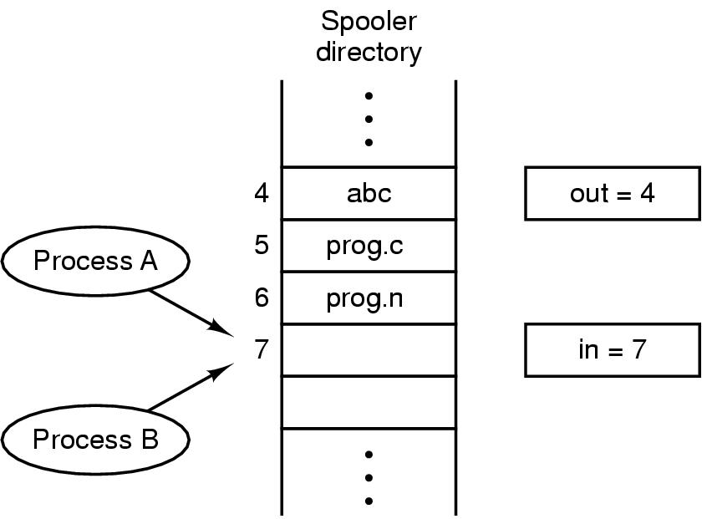
Race Conditions
In is local variable containing pointer to next free slot
Out is local variable pointing to next file to be printed
Race Conditions: Process A reads in and stores the value, 7, in a local variable called next free slot. Just then a clock interrupt occurs and the CPU decides that process A has run long enough, so it switches to process B. Process B also reads in and also gets a 7. It, too, stores it in its local variable next free slot. At this instant both processes think that the next available slot is 7.
Tanenbaum, Modern Operating Systems 3 e, (c) 2008 Prentice-Hall, Inc. All rights reserved. 0-13-6006639
Notes:
Printer daemon prints processes and spooler directory contains files

Slide 23
How to avoid races
Mutual exclusion: some way of making sure that if one process is using a shared variable or file, the other processes will be excluded from doing the same thing.
Critical regions: That part of the program where the process has to access shared memory or files, or do other critical things that can lead to races.
If we could arrange matters such that no two processes were ever in their critical regions at the same time, we could avoid races.
Tanenbaum, Modern Operating Systems 3 e, (c) 2008 Prentice-Hall, Inc. All rights reserved. 0-13-6006639

Slide 24
Properties of a good solution
1. No two processes may be simultaneously inside their critical regions.
2. No assumptions may be made about speeds or the number of CPUs.
3. No process running outside its critical region may block any process.
4. No process should have to wait forever to enter its critical region.
Tanenbaum, Modern Operating Systems 3 e, (c) 2008 Prentice-Hall, Inc. All rights reserved. 0-13-6006639

Slide 25
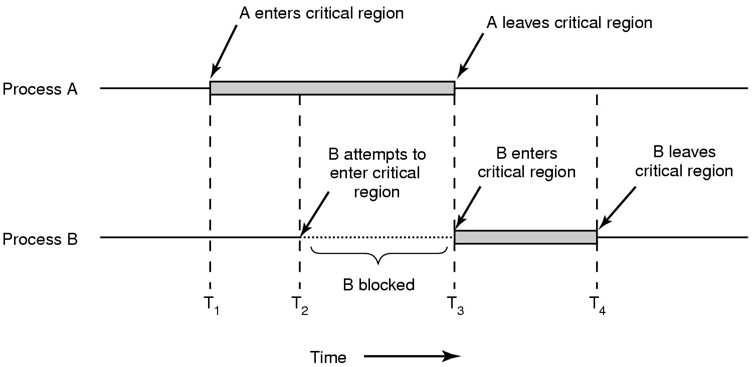
What we are trying to do
Tanenbaum, Modern Operating Systems 3 e, (c) 2008 Prentice-Hall, Inc. All rights reserved. 0-13-6006639

Slide 26
Mutual Exclusion with Busy Waiting
A list of proposals to achieve mutual exclusion
Disabling interrupts
Lock variables
Strict alternation
Peterson's solution
The TSL instruction
Tanenbaum, Modern Operating Systems 3 e, (c) 2008 Prentice-Hall, Inc. All rights reserved. 0-13-6006639

Slide 27
Disabling Interrupts
Each process disables all interrupts just after entering its critical region and re-enable them just before leaving it. With interrupts disabled, no clock interrupts can occur. The CPU is only switched from process to process as a result of clock or other interrupts, after all, and with interrupts turned off the CPU will not be switched to another process.
Problems
It is unwise to give user processes the power to turn off interrupts. What if one of them did it, and never turned them on again? That could be the end of the system.
Won’t work on multi-core chips as disabling interrupts only effects one CPU at a time
Tanenbaum, Modern Operating Systems 3 e, (c) 2008 Prentice-Hall, Inc. All rights reserved. 0-13-6006639

Slide 28
Lock variables
A software solution
Having a single, shared (lock) variable, initially 0.
When a process wants to enter its critical region, it first tests the lock. If the lock is 0, the process sets it to 1 and enters the critical region. If the lock is already 1, the process just waits until it becomes 0.
Thus, a 0 means that no process is in its critical region, and a 1 means that some process is in its critical region.
Problem-Race condition
Tanenbaum, Modern Operating Systems 3 e, (c) 2008 Prentice-Hall, Inc. All rights reserved. 0-13-6006639

Slide 29
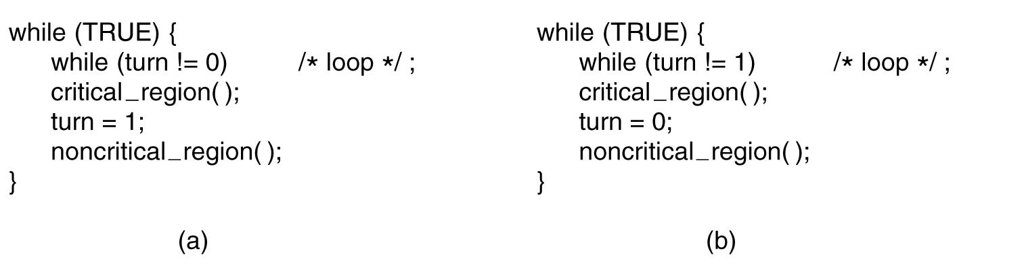
Strict Alternation
First me, then you
(a) Process 0
(b) Process 1
Tanenbaum, Modern Operating Systems 3 e, (c) 2008 Prentice-Hall, Inc. All rights reserved. 0-13-6006639

Slide 30
Problems with strict alternation
Continuously testing a variable until some value appears is called busy waiting. A lock that uses busy waiting is called a spin lock.
It should usually be avoided, since it wastes CPU time.
Only when there is a reasonable expectation that the wait will be short is busy waiting used.
Tanenbaum, Modern Operating Systems 3 e, (c) 2008 Prentice-Hall, Inc. All rights reserved. 0-13-6006639

Slide 31
Problems with strict alternation (cont.)
When process 0 leaves the critical region, it sets turn to 1, to allow process 1 to enter its critical region. Suppose that process 1 finishes its critical region quickly, so that both processes are in their noncritical regions, with turn set to 0. Now process 0 executes its whole loop quickly, exiting its critical region and setting turn to 1. At this point turn is 1 and both processes are executing in their noncritical regions.
Suddenly, process 0 finishes its noncritical region and goes back to the top of its loop. Unfortunately, it is not permitted to enter its critical region now, because turn is 1 and process 1 is busy with its noncritical region. It hangs in its while loop until process 1 sets turn to 0. Taking turns is not a good idea when one of the processes is much slower than the other.
Requires that the two processes strictly alternate in entering their critical regions. Neither one would be permitted twice in a row. While this algorithm does avoid all races, it is not really a serious candidate as a solution because it violates condition 3.
Tanenbaum, Modern Operating Systems 3 e, (c) 2008 Prentice-Hall, Inc. All rights reserved. 0-13-6006639

Slide 32
The Producer-Consumer Problem (Bounded Buffer Problem)
Two processes share a common, fixed-size buffer. One of them, the producer, puts information into the buffer, and the other one, the consumer, takes it out.
Trouble arises when the producer wants to put a new item in the buffer, but it is already full.
The solution is for the producer to go to sleep, to be awakened when the consumer has removed one or more items.
Similarly, if the consumer wants to remove an item from the buffer and sees that the buffer is empty, it goes to sleep until the producer puts something in the buffer and wakes it up.
Tanenbaum, Modern Operating Systems 3 e, (c) 2008 Prentice-Hall, Inc. All rights reserved. 0-13-6006639

Slide 33
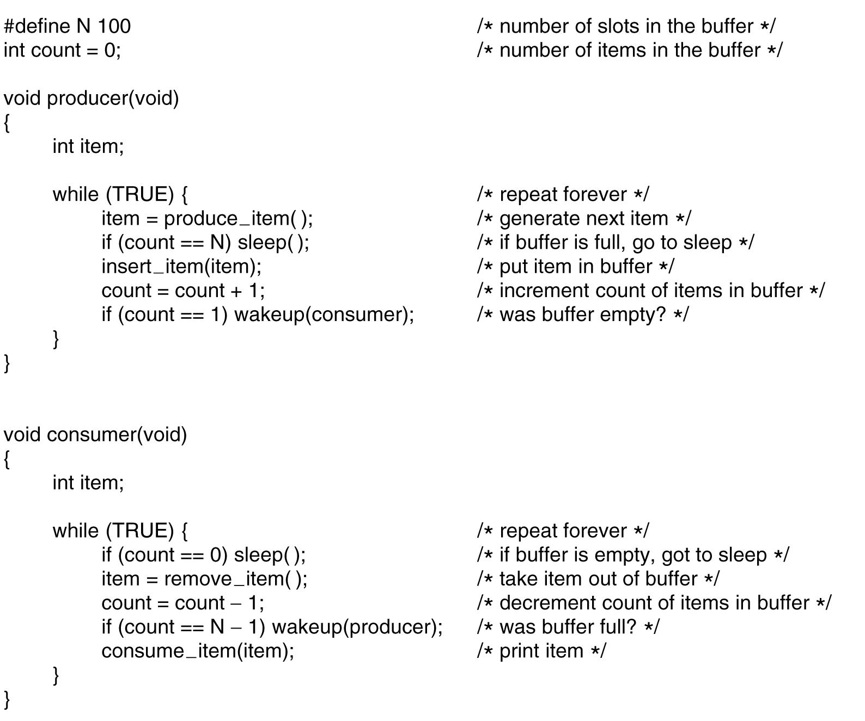
The Producer-Consumer Problem (Bounded Buffer Problem) (read only)
Tanenbaum, Modern Operating Systems 3 e, (c) 2008 Prentice-Hall, Inc. All rights reserved. 0-13-6006639

Slide 34
The problem with sleep and wake-up calls
Empty buffer, count==0
Race conditions we saw earlier.
It can occur because access to count is unconstrained. As a consequence, the following situation could possibly occur. The buffer is empty and the consumer has just read count to see if it is 0. At that instant, the scheduler decides to stop running the consumer temporarily and start running the producer.
The producer inserts an item in the buffer, increments count, and notices that it is now 1, sends wakeup to consumer
Consumer not asleep, ignores wakeup, thinks count== 0, goes to sleep
Producer fills buffer, goes to sleep
P and C sleep forever
So the problem is lost wake-up calls
Tanenbaum, Modern Operating Systems 3 e, (c) 2008 Prentice-Hall, Inc. All rights reserved. 0-13-6006639

Slide 35
Semaphores
Semaphore is an integer variable used to count the number of wakeups saved
Semaphore could have the value 0, indicating that no wakeups were saved, or some positive value if one or more wakeups were pending.
Two operations, down and up (sleep and wakeup)
Down checks semaphore. If not zero, decrements semaphore. If zero, process goes to sleep.
Up increments semaphore. If more than one process is asleep, one is chosen randomly and enters critical region.
Checking the value, changing it, and possibly going to sleep, are all done as a single, indivisible ATOMIC ACTION.
Tanenbaum, Modern Operating Systems 3 e, (c) 2008 Prentice-Hall, Inc. All rights reserved. 0-13-6006639

Slide 36
Producer Consumer with Semaphores (Lab)
Tanenbaum, Modern Operating Systems 3 e, (c) 2008 Prentice-Hall, Inc. All rights reserved. 0-13-6006639

